Slide 1
Arrays

Slide 2
I/O
import java.util.Scanner;
public class ArrayInputDemo {
public static void main(String[] args) {
Scanner sc = new Scanner(System.in);
int[] arr; // Declaration
System.out.print("Enter array size: ");
int n = sc.nextInt();
arr = new int[n]; // Initialization
System.out.println("Enter " + n + " elements:");
for (int i = 0; i < arr.length; i++) {
arr[i] = sc.nextInt(); }
System.out.println("Array elements:");
System.out.println("Traversal using for loop:");
for (int i = 0; i < arr.length; i++) {
System.out.print(arr[i] + " "); }
System.out.println("\nTraversal using for-each loop:");
for (int value : arr) {
System.out.print(value + " "); }
sc.close(); }}

Slide 3
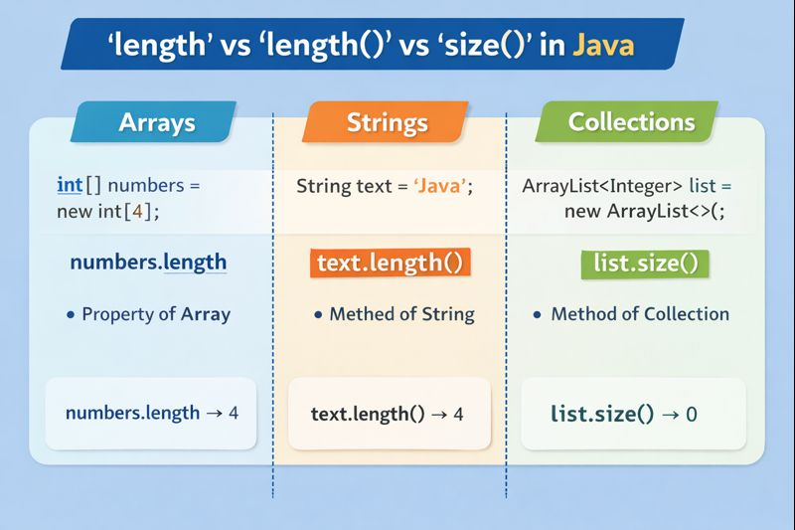

Slide 4
Linear Search
Linear Search is a simple searching technique
It checks each element one by one
Continues until:
  the element is found
  OR the array ends
Advantages
Easy to understand
Works on unsorted arrays
Good for small data
Disadvantages
Slow for large arrays
More comparisons
Case | Time
Best Case | O(1)
Worst Case | O(n)
Average Case | O(n)

Slide 5
Linear Search
import java.util.Scanner;
public class LinearSearchDemo {
public static void main(String[] args) {
Scanner sc = new Scanner(System.in);
int[] arr = new int[5];
System.out.println("Enter 5 elements:");
for (int i = 0; i < arr.length; i++) {
arr[i] = sc.nextInt(); }
System.out.print("Enter element to search: ");
int key = sc.nextInt();
int index = -1;
for (int i = 0; i < arr.length; i++) {
if (arr[i] == key) {
index = i;
break; } }
if (index != -1)
System.out.println("Element found at index: " + index);
else
System.out.println("Element not found");
sc.close(); }}

Slide 6
Binary Search
Binary Search is a fast searching technique
It works by dividing the array into halves
IMPORTANT: Array must be sorted
Working
Find the middle element
Compare middle element with the key
If:
  key == middle → Found
  key < middle → search left half
  key > middle → search right half
  Repeat until found or range becomes empty
Case | Time
Best Case | O(1)
Average Case | O(log n)
Worst Case | O(log n)
Advantages
Very fast searching
Fewer comparisons
Efficient for large datasets
Disadvantages
Works only on sorted arrays
Slightly more complex logic

Slide 7
Binary Search
import java.util.Scanner; import java.util.Arrays; public class BinarySearchDemo { public static void main(String[] args) { Scanner sc = new Scanner(System.in); int[] arr = new int[5]; for (int i = 0; i < arr.length; i++) { arr[i] = sc.nextInt(); } Arrays.sort(arr); int key = sc.nextInt(); int low = 0, high = arr.length - 1; int index = -1; | while (low <= high) { int mid = (low + high) / 2; if (arr[mid] == key) { index = mid; break; } else if (key < arr[mid]) { high = mid - 1; } else { low = mid + 1; } } if (index != -1) System.out.println("Element found at index: " + index); else System.out.println("Element not found"); sc.close(); }}

Slide 8
Min, Max, 2^{nd -} Min, Max
public class MinMaxSecondMinSecondMax { public static void main(String[] args) { int[] arr = {12, 5, 8, 20, 3, 15}; int min = Integer.MAX_VALUE; int secondMin = Integer.MAX_VALUE; int max = Integer.MIN_VALUE; int secondMax = Integer.MIN_VALUE; for (int value : arr) { if (value < min) { secondMin = min; min = value; } else if (value < secondMin && value != min) { secondMin = value; } | if (value > max) { secondMax = max; max = value; } else if (value > secondMax && value != max) { secondMax = value; }} System.out.println("Min = " + min); System.out.println("Second Min = " + secondMin); System.out.println("Max = " + max); System.out.println("Second Max = " + secondMax); }}

Slide 9
Reverse without 2nd array
public class ReverseArray { public static void main(String[] args) { int[] arr = {10, 20, 30, 40, 50}; int start = 0; int end = arr.length - 1; while (start < end) { int temp = arr[start]; arr[start] = arr[end]; arr[end] = temp; start++; end--; } for (int value : arr) { System.out.print(value + " ");}}}

Slide 10
Left Rotate for k positions
public class RotateArrayLeft { static void reverse(int[] arr, int start, int end) { while (start < end) { int temp = arr[start]; arr[start] = arr[end]; arr[end] = temp; start++;end--;}} public static void main(String[] args) { int[] arr = {1, 2, 3, 4, 5}; int k = 2; k = k % arr.length; reverse(arr, 0, k - 1); reverse(arr, k, arr.length - 1); reverse(arr, 0, arr.length - 1); for (int value : arr) { System.out.print(value + " ");}}}

Slide 11
Right Rotate for k positions
public class RotateArray { static void reverse(int[] arr, int start, int end) { while (start < end) { int temp = arr[start]; arr[start] = arr[end]; arr[end] = temp; start++;end--;}} public static void main(String[] args) { int[] arr = {1, 2, 3, 4, 5}; int k = 2; k = k % arr.length; reverse(arr, 0, arr.length - 1); reverse(arr, 0, k - 1); reverse(arr, k, arr.length - 1); for (int value : arr) { System.out.print(value + " ");}}}

Slide 12
Remove duplicates without 2nd array
import java.util.Arrays; public class RemoveDuplicatesSorted { public static void main(String[] args) { int[] arr = {4, 2, 4, 1, 2, 3, 3}; Arrays.sort(arr); int j = 0; for (int i = 0; i < arr.length - 1; i++) { if (arr[i] != arr[i + 1]) { arr[j++] = arr[i]; } } arr[j++] = arr[arr.length - 1]; for (int i = 0; i < j; i++) { System.out.print(arr[i] + " ");}}}
for (int i = 0; i < n - 1; i++) {
for (int j = i + 1; j < n; j++) {
if (arr[i] > arr[j]) {
int temp = arr[i];
arr[i] = arr[j];
arr[j] = temp; } } }

Slide 13
Count the frequency of each element in array
public class FrequencyWithoutExtraSpace { public static void main(String[] args) { int[] arr = {10, 20, 10, 30, 20, 10}; boolean[] visited = new boolean[arr.length]; for (int i = 0; i < arr.length; i++) { if (visited[i]) continue; int count = 1; for (int j = i + 1; j < arr.length; j++) { if (arr[i] == arr[j]) { visited[j] = true; count++; } } System.out.println(arr[i] + " -> " + count); }}}

Slide 14
